Slide 1
The Design of Safety Critical Systems
Safety Cases
Alan Harding

Slide 2
Safety Case
  A structured and documented body of evidence that provides a convincing argument that a system is adequately safe for a given application in a given environment

Slide 3

THE BASIC SAFETY CASE ARGUMENT
ACCEPTABLY SAFE
ALL SAFETY HAZARDS ARE IDENTIFIED, ASSESSED AND ADDRESSED
ALL APPROPRIATE STANDARDS ARE IMPLEMENTED AND SATISFIED
Lancaster University

Slide 4
The Safety Case
A safety case:
· makes an explicit set of claims about the system
· provides the supporting evidence
· provides a set of safety arguments that link the claims to the evidence
· makes clear the assumptions and judgements underlying the arguments

Slide 5
Offshore Safety Case Regulations (2005)
The Safety Case
The safety case provides a comprehensive core
document that can be used as a check by both the duty holder and HSE that the accepted risk control measures and the health and safety management systems
are in place and operate as they should.
Verification
The overall objective of the verification scheme is to establish a system of independent and competent scrutiny of safety-critical elements throughout the life cycle of an installation, to obtain assurance that satisfactory standards will be achieved and maintained…….. It will therefore be helpful to include a summary of the scheme in the safety case.

Slide 6
ONR GUIDE
Document Type: ONR Nuclear Safety Technical Assessment Guide : NS-TAST-GD-051 Revision 3
Date Issued: July 2013 Review Date: July 2016
Revision commentary: Update to reflect the ONR Safety Case Principles and lessons from experience

Slide 7
MoD Guide
DEF STAN 00-96

Slide 8
System
Management Culture
Training
Operator
Environment
Equipment

Slide 9
Evidence
Deterministic application of predetermined rules to derive a true/false claim (given some initial assumptions), e.g. formal proof of compliance to a specification, or demonstration of a safety requirement (such as execution time analysis or
exhaustive test of the logic)
Probabilistic quantitative statistical reasoning, to establish a numerical level (e.g. MTTF, MTTR, reliability testing)
Qualitative compliance with rules that have an indirect link to the desired attributes (e.g. compliance with QMS standards, staff skills and experience)

Slide 10
Format
Claim
Argument
Evidence

Slide 11
Sources of Evidence
the design and design processes
the development process
simulated experience (via reliability testing)
prior field experience

Slide 12
Integration into the Design Process
the design implements the safety functions and attributes
the design criteria are satisfied
the design is feasible
the associated safety arguments are credible
the approach is cost-effective

Slide 13
Safety Case Life Cycle
Safety functions and top-level safety attributes identification
System architecture and outline safety case identification
Progressive elaboration of the design and safety case in parallel
Long-term support infrastructure plans
Long-term monitoring and audits
System updates and corrections

Slide 14
Safety Case Content
Environment description
Safety requirements
System architecture, subsystems, interconnections, subsystem derived functions, integrity levels, design assumptions
Supporting evidence and analyses (e.g. FMECA)
Long term support requirements
Maintenance and operation procedures
Evidence of quality and safety management

Slide 15
Safety Case Formats
Goal Structuring Notation (GSN)
Developed by University of York in 1995 for UKMOD
Elements:
Goals, context, assumptions, strategy, evidence

Slide 16
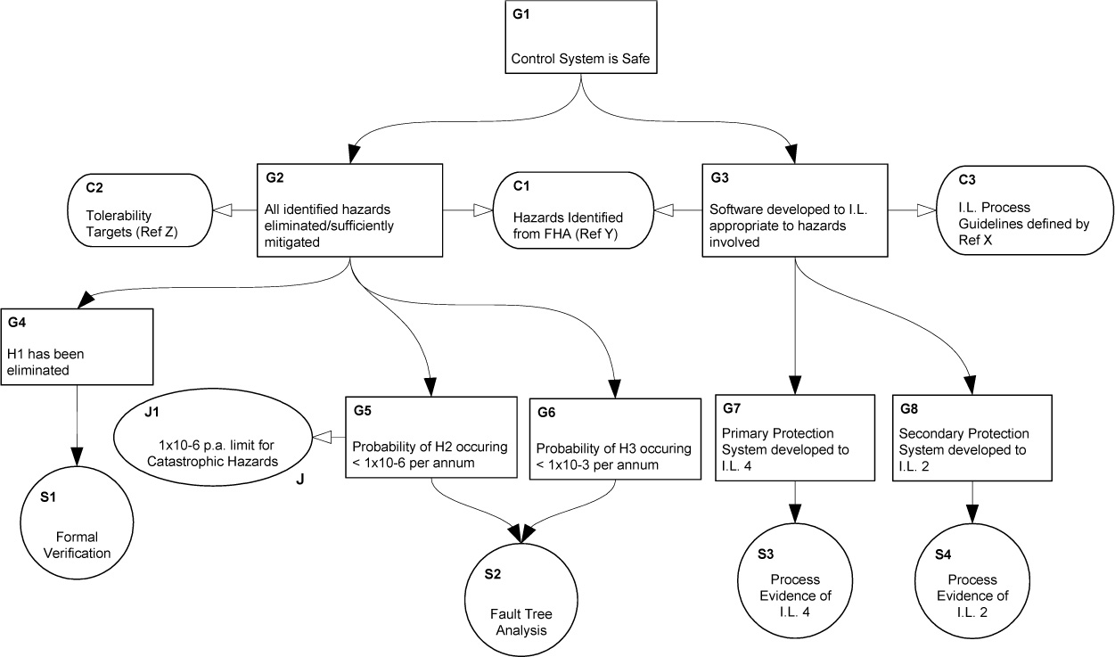
GSN Example
The Safety Engineer Resource

Slide 17
GSN
Can be unwieldy
Configuration Management can be difficult
Proportionality is not represented

Slide 18
Other Layouts
Establish:
System Safe: Control system is acceptably safe
Given:
A. Definition of acceptably safe.
Statements | Reasons
All identified hazards have been eliminated or mitigated | 1.Hazards handled : Established below
Software has been developed to the safety integrity level appropriate to the hazards | 2.Process acceptable: Established below
Control System is Acceptably Safe | 3. : 1, 2
Statements | Reasons
1. All identified hazards | 1. HazardsHandled
have been eliminated or | (established below)
sufficiently mitigated | 2. Process Acceptable
2. The software has
been developed to the | (established below)
integrity level
appropriate to the
hazards identified
3. Control system is | 3. 1,2
acceptably safe
NASA Langley Research Center

Slide 19
Other Layouts
Establish:
Hazards Handled: All identified hazards have been eliminated or sufficiently mitigated
Given:
A.Tolerability targets for hazards (reference Z).
B. Hazards identified from functional hazard analysis (reference Y).
By: Arguing over all identified hazards (H1, H2, H3)
Statements | Reasons
1. H1 has been eliminated | Formal Verification
2. p(H2) < 1x10-6 per annum (p.a.) | Fault Tree Analysis

